Slide 1

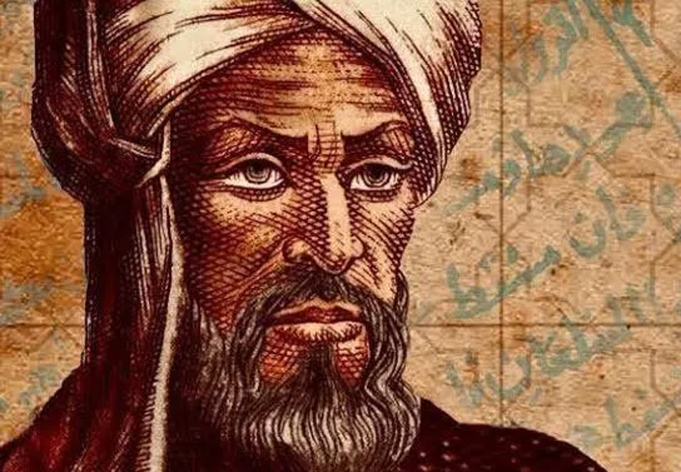
AL KHWARIZMI – BIRTH OF ALGEBRA

Slide 2
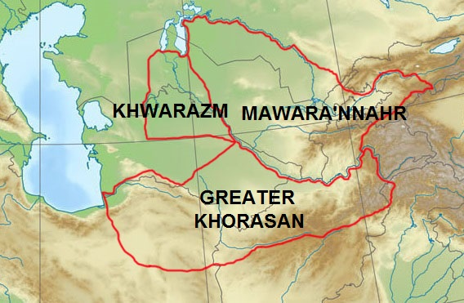
Al-Khwarizmi was born and raised in the region of Khwarazm. The year 783 is accepted as his year of birth. It is believed that he received his initial education and knowledge in various fields mainly in his homeland.

Slide 3
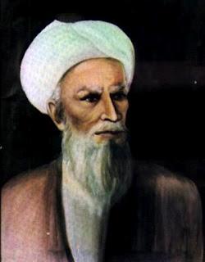
In historical sources, additional titles such as al-Majusi and al-Qutrubbuli are attached to his name.
AL-TABARI GIVES HIS NAME AS MUHAMMAD IBN MUSA AL-KHWARIZMI AL-MAJUSI AL-QUTRUBBULLI.
It was customary among Arabs to give a person several nisbas (descriptive names) based on their distinctive traits, professions, favorite habits, or places of residence. Thus, al-Khwarizmi’s title al-Qutrubbuli also appeared in this manner.
Zoroastrian family
(the Arabic word “Majus” means “fire-worshipper”)

Slide 4
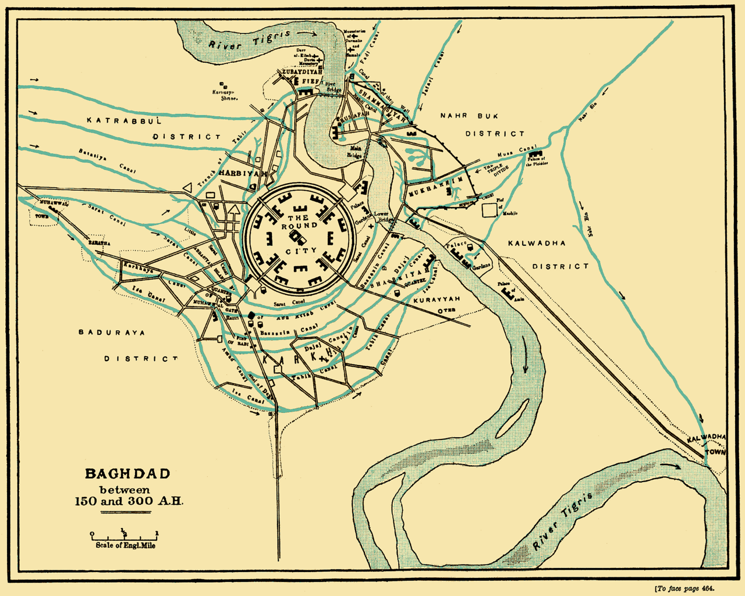
The second title, al-Qutrubbuli, indicates that al-Khwarizmi spent his later years or born near Baghdad, in al-Qutrubbul, located by the Tigris River. However, this ideas could be altogether wrong
The Tigris River is known as Dajla دجلة) ) in Arabic

Slide 5
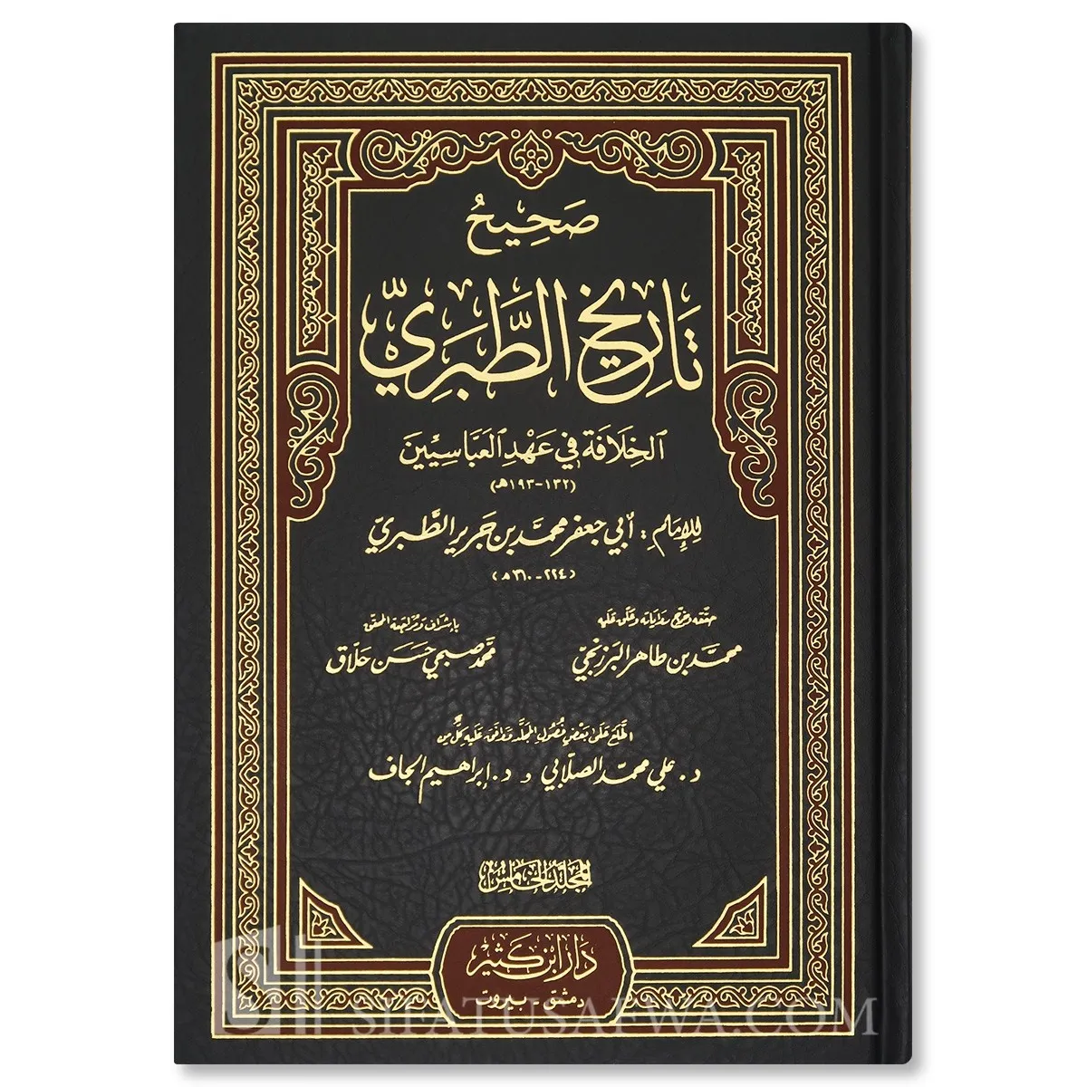
Al-Tabari himself explicitly stated in the introduction to his famous historical chronicle (Tarikh Al-Tabari) that his method was to transmit reports as he received them from others, leaving the task of authentication to the reader or future scholars.

Slide 6


The epithet al-Qutrubbulli could indicate he might instead have come from Qutrubbul (Qatrabbul), near Baghdad.
There is no need to be an expert on the period or a philologist to see that al-Tabari's second citation should read "Muhammad ibn Mūsa al-Khwārizmī and al-Majūsi al-Qutrubbulli," and that there are two people (al-Khwārizmī and al-Majūsi al-Qutrubbulli) between whom the letter wa [Arabic '' وfor the conjunction 'and'] has been omitted in an early copy. This would not be worth mentioning if a series of errors concerning the personality of al-Khwārizmī, occasionally even the origins of his knowledge, had not been made. Recently, G.J. Toomer ... with naive confidence constructed an entire fantasy on the error which cannot be denied the merit of amusing the reader.
Roshdi Rashed, Egyptian mathematician, philosopher and historian of science
Gerald J. Toomer, British historian of astronomy and mathematics

Slide 7
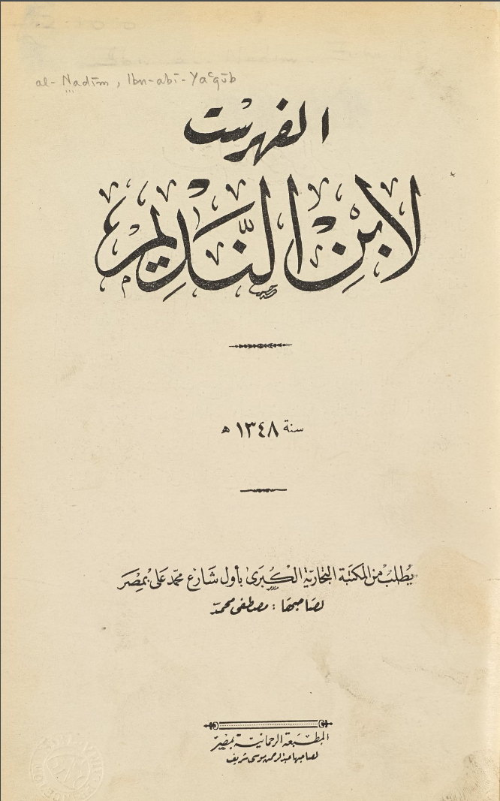
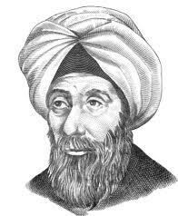
Ibn al-Nadim's Al- Fihrist includes a short biography on al-Khwarizmi together with a list of his books.

Slide 8
813-833 A.D
820 A.D
20 works
10 known
7 survived

Slide 9
Four of these works are preserved in Arabic, one survives as part of al-Farghani’s writings, two are available in Latin translation, and the remaining three have not yet been found.

Slide 10
The Compendious Book on Calculation by Completion and Balancing (Al-Jabr)
The Book on Indian Calculation” or “The Book on Addition and Subtraction
Kitab Surat al-Ard
Zij (astronomical tables)
Book on the Use of the Astrolabe
Book on the Construction of the Astrolabe
Determining the Azimuth by Means of the Astrolabe
Kitab ar- Rukhama
Kitab at-Tarikh
Treatise on the Jewish Calendar and the Determination of Their Festivals

Slide 11
first systematic exposition of algebra
813 and 833
AL-JABR
entirely in words
daily events

Slide 12
The algebraic part
The geometric part
The part on inheritance laws

Slide 13
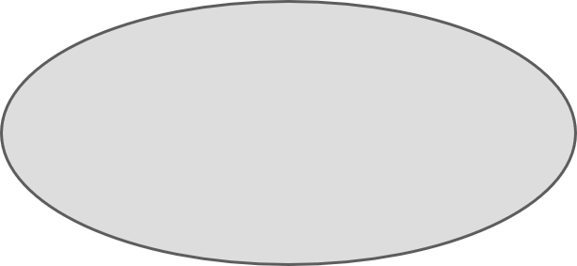





simplification of terms of the same power of terms
cancellation of like terms
50 + 3x + x² = 29 + 10x
The goal is to eliminate negative terms
21 + x² = 7x
x² = 40x - 4x²
5x² = 40x
AL-MUQABALA

Slide 14
He called the unknown number "shay," which means "thing."

Slide 15
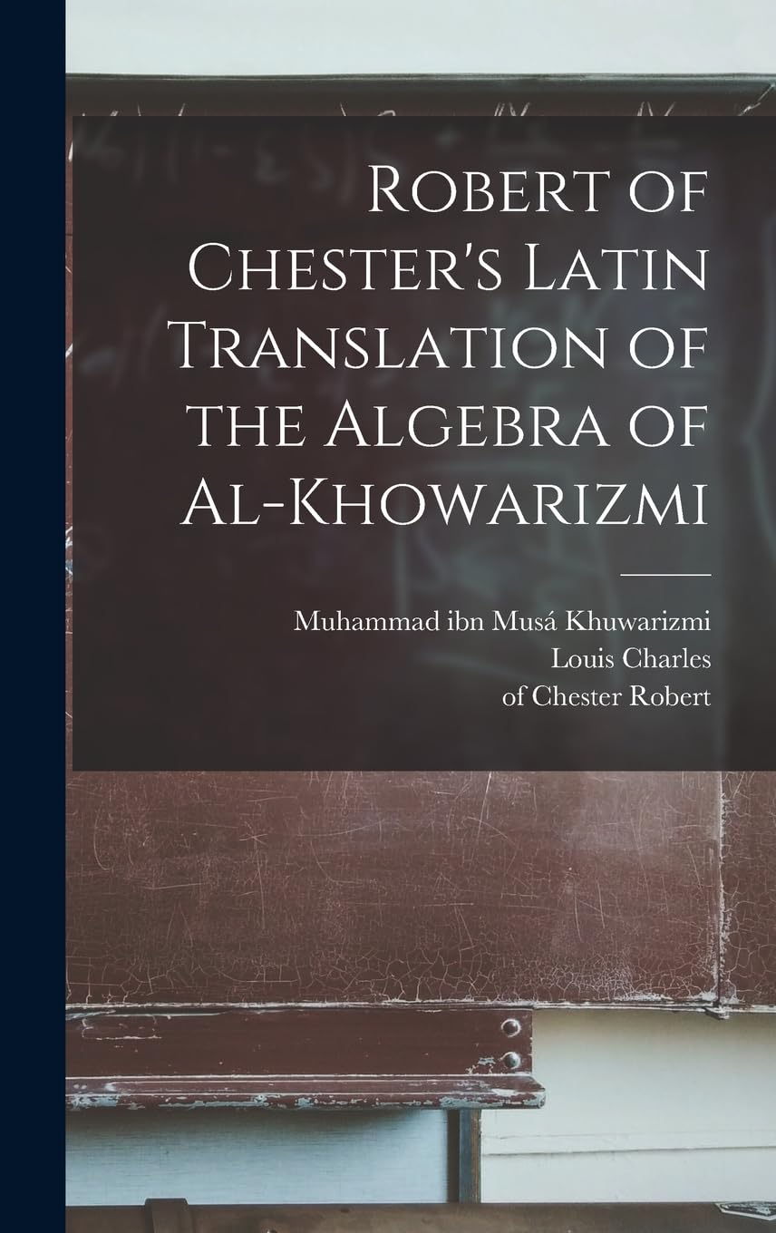
THE BOOK WAS TRANSLATED IN LATIN AS “LIBER ALGEBRAE ET ALMUCABALA” BY ROBERT OF CHESTER (SEGOVIA, 1145) HENCE "ALGEBRA"

Slide 16
surviving Arabic copy of the text is preserved at the Bodleian library at the university of oxford. manuscript was transcribed in 1342 (over 500 years after al-khwarizmi wrote the original).
https://digital.bodleian.ox.ac.uk/objects/1597877d-50cf-46d4-8d46-18f89ee943cf/surfaces/86bc3d01-5ec2-4005-8366-88f3a7b9a599/

Slide 17
This operations was known well before al-Khwarizmi. What do you think make al Khwarizmi and his work so special?

Slide 18
The exact date when al-Khwarizmi wrote his arithmetic treatise is unknown. However, since he refers to his algebraic treatise in it, the arithmetic work was written after the algebraic one. The treatise was translated into Latin in Spain in the 12th century. When the work was translated into Latin in the 12th century as Algoritmi de numero Indorum (Al-Khwarizmi on the Hindu art of reckoning), the term "algorithm" was introduced to the Western world. The only surviving Latin manuscript, copied in the 14th century, is kept at the Cambridge University Library. The text begins with the phrase “Dixit Algorithmi”, meaning “Al-Khwarizmi said.”
https://cudl.lib.cam.ac.uk/view/MS-II-00006-00005/7\

Slide 19

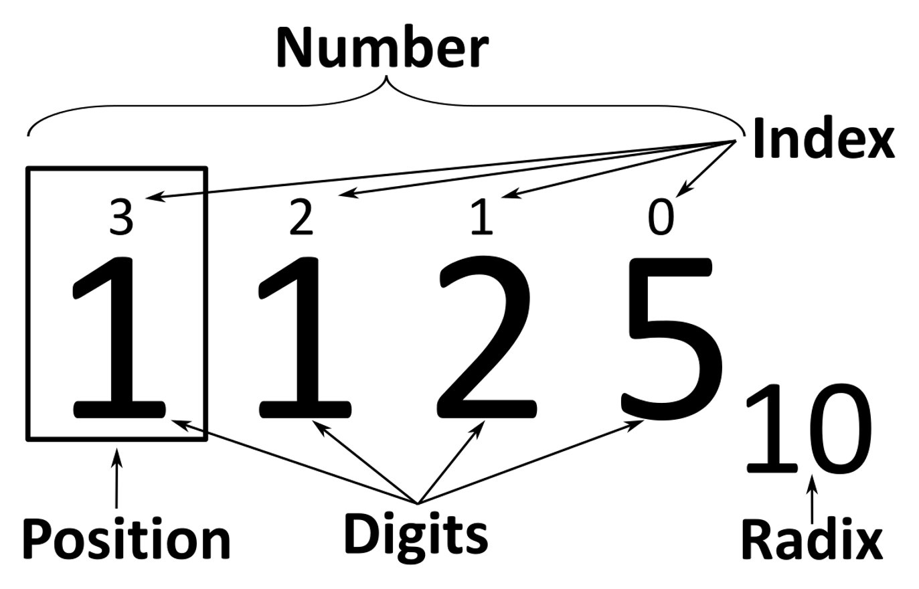
In this work, al-Khwarizmi explains the advantages of the nine Indian numerals in representing numbers, stating that with their help, any number can be written briefly and easily. He emphasizes importance of using zero. He then proceeds to explain arithmetic operations, advising readers to pay close attention to the placement of digits (their positional value) and to never forget to write zero — otherwise, the result will be incorrect. At the beginning of the treatise, al-Khwarizmi notes that the problems and examples included in the work were written in response to the practical needs of his time.

Slide 20
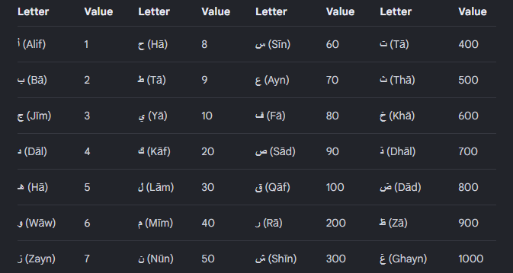
Abjad numeral system

Slide 21
37 chapters
830
ZIJ
converting dates between the eras
116 tables

Slide 22
There is only one surviving copy of Kitāb Ṣūrat al-Arḍ (“The Book of the Image of the Earth”), which is kept at Strasbourg University Library. A Latin translation of it is preserved at the National Library of Spain in Madrid.
https://iiif.biblissima.fr/collections/manifest/604c42f4a572601c9208159764b74335d60ca77a

Slide 23
Al-Khwarizmi also corrected Ptolemy’s major mistake about the length of the Mediterranean Sea. Ptolemy had estimated it as 63° of longitude, but Al-Khwarizmi measured it more accurately at about 50°. He also showed that the Atlantic and Indian Oceans were open seas, not closed bodies of water as Ptolemy had drawn.

Slide 24
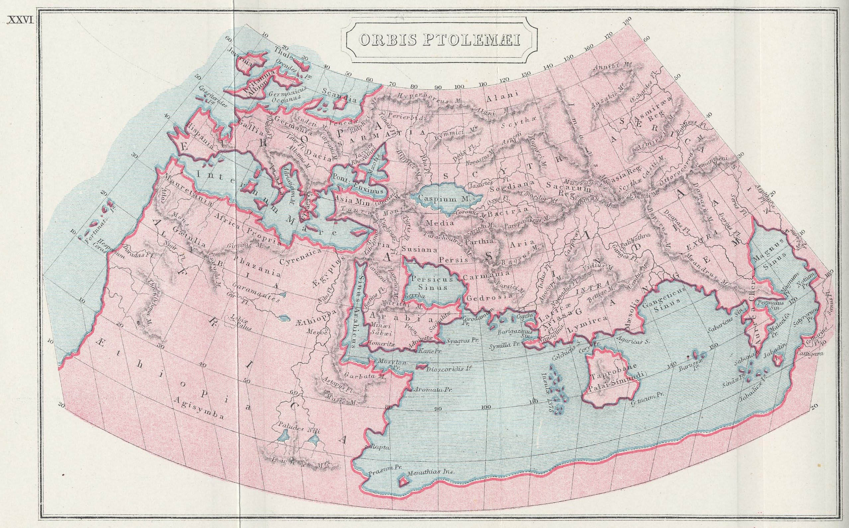

Slide 25
Neither the Arabic original nor the Latin translation includes the world map itself. However, scholar Hubert Daunicht was able to reconstruct the missing map using the coordinate lists. He plotted the readable coastal, river, and city coordinates on graph paper and connected them with lines, recreating an approximate version of Al-Khwarizmi’s original map.

Slide 26
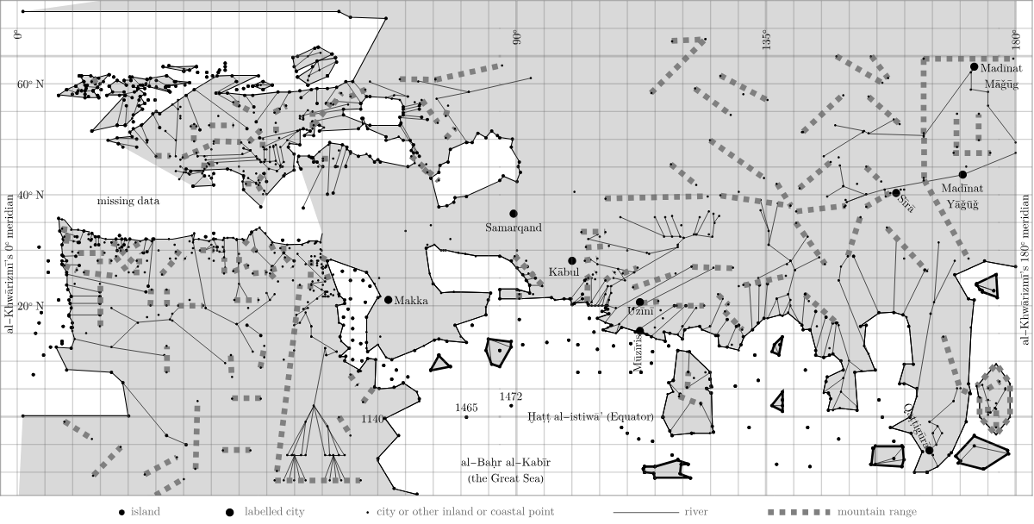

Slide 27
His Prime Meridian (the zero line of longitude) ran through the Fortunate Isles (Canary Islands), about 10° east of the one used by Ptolemy and Marinus. Later medieval Muslim geographers continued to use Al-Khwarizmi’s system. google.com/maps/@41.818631,-34.6097067,8185117m/data=!3m1!1e3?authuser=0&entry=ttu&g_ep=EgoyMDI2MDkyMS4wIKXMDSoASAFQAw%3D%3D

